Slide 1

Finding Paths from Houses to Safehouses
This presentation explores the development of a project that focuses on finding optimal evacuation routes from houses to safehouses in a simulated environment. The project utilizes map data, pathfinding algorithms, and dynamic fire spread simulation to create a realistic and relevant model for disaster preparedness.

Slide 2
Project Overview
Our project simulates a scenario where a wildfire breaks out in a populated area. It uses a map representation with varying terrain features. The map contains houses and safehouses. The objective is to find the shortest and safest paths for residents to evacuate from their homes to the designated safehouses.
We implemented a pathfinding algorithm to calculate these routes, considering various factors including terrain characteristics, fire spread dynamics, and the real-time evolution of the firefront. This approach aims to ensure the most efficient and safest evacuation strategies.

Slide 3
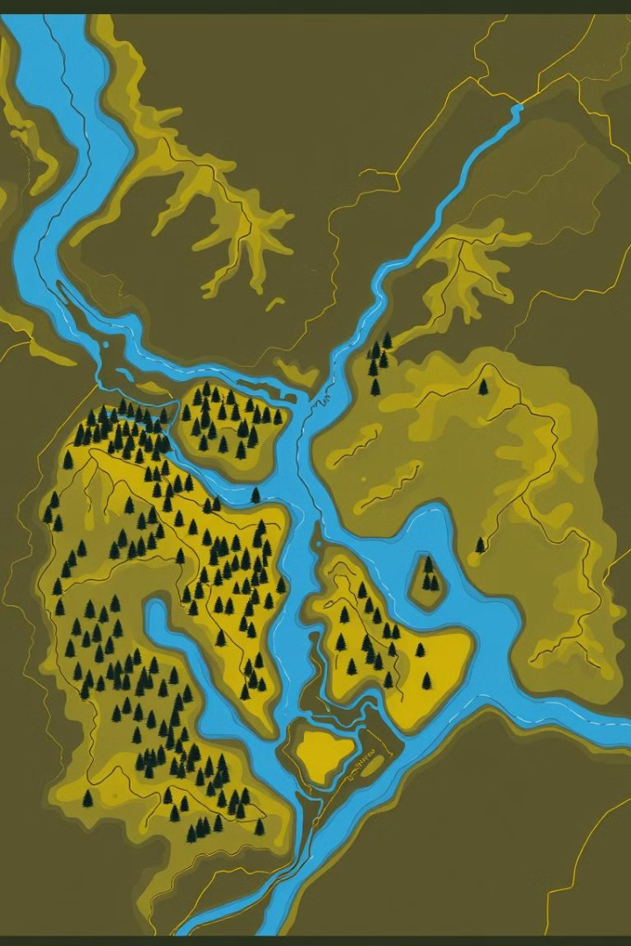
Map Elements: Forests, Water, Hills
Forests
Water
Represented by green areas, forests pose moderate difficulty for evacuation due to potential fire ignition and spreading. The algorithm considers the presence of forests and the possibility of fire propagation through them.
Water bodies are shown in blue and represent the most challenging areas to cross during evacuation. The algorithm assigns a higher cost to traversing water, reflecting the difficulty and potential dangers.
Hills
Hills are indicated by a brown color and present a moderate challenge for evacuation. The algorithm considers the elevation changes associated with hills and assigns a cost accordingly.

Slide 4
Cost Order: Water > Hills > Forests > Land
1
2
3
Water
Hills
Forests
The highest cost, representing the most difficult terrain to traverse.
Moderate cost, reflecting the challenges of navigating slopes and elevation changes.
Moderate cost, considering the risk of fire spread and potential obstacles within forests.
4
Land
The lowest cost, representing the easiest terrain for evacuation.

Slide 5
Why A* Algorithm?
Advantages of A* Over Other Algorithms*
Optimal and Complete:
A* guarantees finding the shortest path if the heuristic is admissible (never overestimates) and consistent.
Unlike Greedy Best-First Search, it doesn’t settle for suboptimal solutions.
Heuristic-Based Efficiency:
The combination of actual cost g(x) and estimated cost h(x) allows A* to explore fewer nodes than Dijkstra’s algorithm.
Balances speed and accuracy, making it suitable for dynamic environments like wildfire evacuation.
Flexibility:
Can incorporate terrain costs and dynamic changes, critical for this project’s fire spread simulation.
The algorithm adapts well to varying terrains and obstacles.

Slide 6




A* Algorithm for Path Planning
1
Heuristic Function
2
Cost Function
3
Node Expansion
4
Path Construction
We implemented the A* algorithm to find the most efficient paths from houses to safehouses, taking into account the terrain cost and fire spread. The algorithm prioritizes paths that minimize the total travel time, considering the challenges posed by different terrains.

Slide 7
Time and Space Complexity
Algorithm | Time Complexity | Space Complexity
A* Algorithm Dijkstra's Algorithm Bellman Ford Algorithm | Worst-Case : O(E) O(V log V + E) O(V*E) | O(V) O(V) O(V)
A* is often better because it uses a heuristic to guide the search toward the goal, reducing the number of nodes explored. This makes it more efficient than Dijkstra’s algorithm O(V log V+E) or Bellman-Ford O(V×E) in many cases, as those algorithms explore all possible paths without guidance.

Slide 8
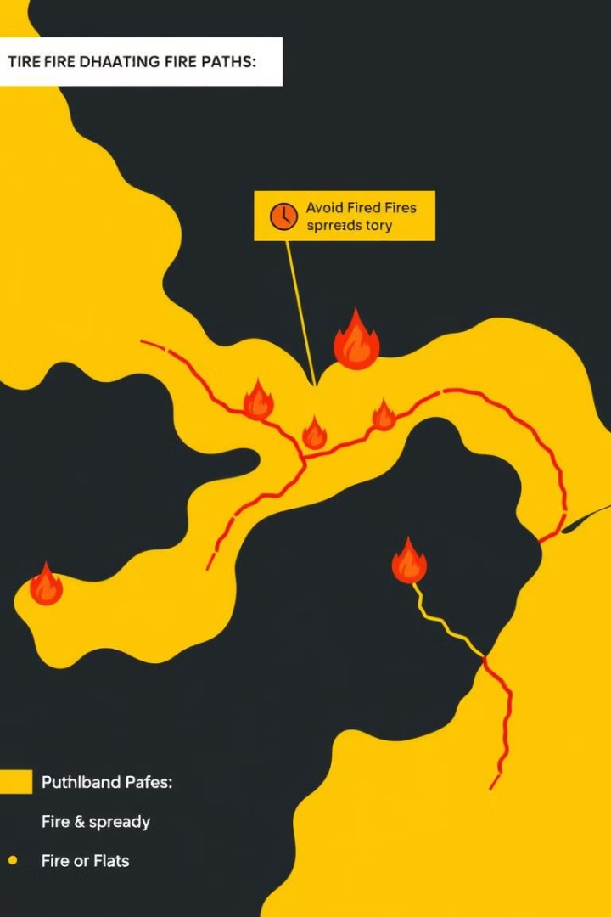
Dynamic Path Changes with Fire Spread
1
The fire spreads dynamically, changing the map's landscape. We implemented a fire spread model to simulate its propagation through different terrain types.
2
The algorithm then recalculates the evacuation paths in real time, factoring in the changing firefront. This allows for dynamic adjustments to the paths, ensuring the most efficient and safe routes are always available.
3
The paths can change rapidly as the fire progresses, highlighting the importance of dynamic path planning. This project demonstrates how a combination of pathfinding algorithms and fire simulation can be used to develop effective evacuation strategies during wildfire emergencies.

Slide 9


Randomly Generated Houses and Safehouses
Houses
Safehouses
The locations of houses are randomly generated within the map, ensuring a realistic and varied distribution.
Safehouses are also randomly generated across the map, creating different scenarios and distances for evacuation.

Slide 10
Buffer Zones for Enhanced Safety
What Are Buffer Zones?
Areas surrounding houses and safehouses designated to slow down the spread of fire.
Act as protective barriers, reducing the risk of immediate fire exposure to critical locations.
How Buffer Zones Are Created
Around Houses:
Buffer radius is applied around each house location.
Ensures residents have time to evacuate safely without direct fire exposure.
Around Safehouses:
Buffer zones around safehouses keep them accessible for evacuees.
Prevents fire from blocking access to these critical locations.

Slide 11
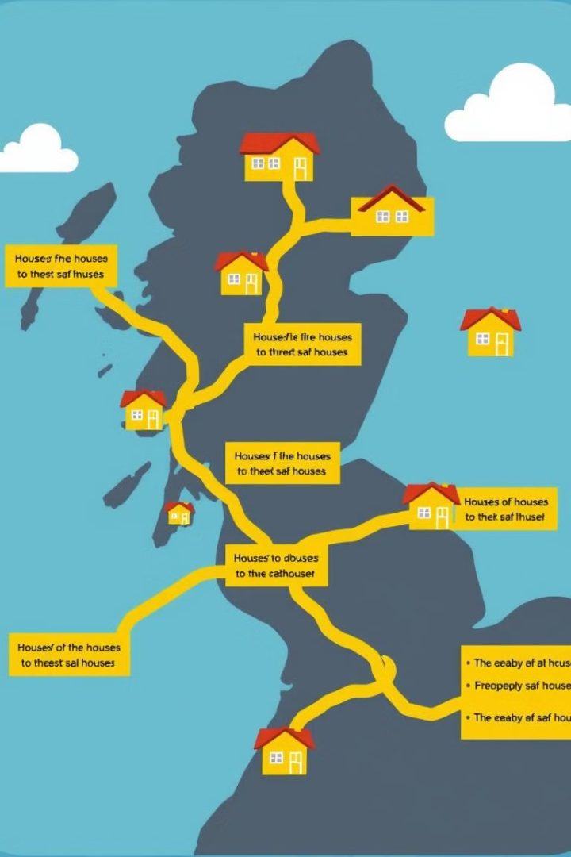
Project Conclusion and Next Steps
Project Conclusion
Next Steps
The project successfully demonstrated how to use pathfinding algorithms and fire spread simulations to generate dynamic evacuation routes in a fire-affected environment. This research lays the groundwork for future development and implementation of more comprehensive evacuation planning systems.
Future work could explore more advanced algorithms for path planning, including multi-objective optimization to consider factors like terrain, fire spread, and population density.

